Slide 1
SC1015
Mini Project
Tut Group : FDDA (Group 4)
Nadya Yuki Wangsajaya [U2320059K]
Nang Kal San Hom [U2321661K]
Shiu Lok Chun, Wesley [U2321673A]

Slide 2

Predicting Spotify Popularity Score
DSAI Mini-Project
Nadya Yuki Wangsajaya [U2320059K]
Nang Kal San Hom [U2321661K]
Shiu Lok Chun, Wesley [U2321673A]
By Group 4
Notes:
Hello! We are Group4 from tutorial group FDDA and we will be presenting our mini project for our SC1015 mod in this video. In this project, we will be using various factors to predict popularity scores on Spotify.

Slide 3
Table of Contents
01
02
03
04
Data Extraction and Visualisation
Data Resampling
Predicting Popularity From Audio Features
Predicting Popularity From Artist, Genre, and Date

Slide 4
Our Motivation
Why do we need to predict Spotify’s popularity score?
Notes:
So what is our motivation behind predicting Spotify’s popularity score?

Slide 5




Our Record Label Company
Scout and recruit talented artists
Step 1:
Guide them to release popular music
Step 2:
Step 3:
?????
Profit!!!
Step 4:
Notes:
We are a record label company, meaning that we trademark and own music. By utilizing the art of data science and AI, we aim to bring about the success of our company! Firstly, we look to bring in talented artists by predicting if they will be popular through our algorithm. After recruiting these artists, we will guide them to release popular music by adjusting their audio features. Ultimately, we hope to maximise our music’s popularity and hence, our company’s profit.

Slide 6
01A
Data Extraction
Forming datasets
Notes:
Firstly, we will take you through the data extraction process to form our datasets.

Slide 7


Formation of Dataset
Internet
Dataset File
Notes:
Instead of using purely online datasets, we decided to make our own by extracting data directly from Spotify. This was done using the Spotify API ‘Spotipy’.

Slide 8

Formation of Dataset
Spotify API
Spotify
Dataset File
Notes:
Instead of using purely online datasets, we decided to make our own by extracting data directly from Spotify. This was done using the Spotify API ‘Spotipy’.

Slide 9
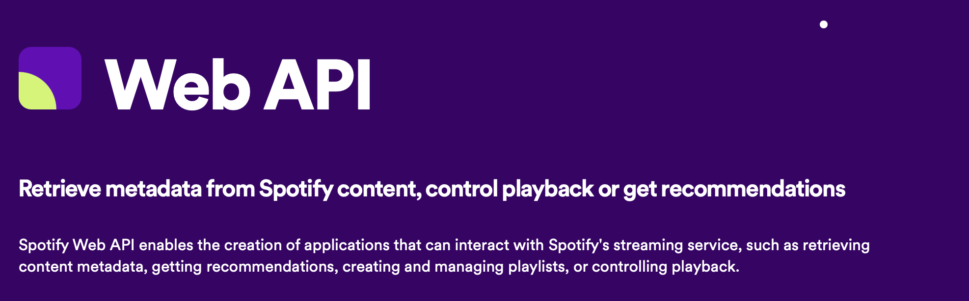

Spotify API
Audio Features
Extract detailed information about Spotify tracks and artists
Popularity Scores
Artist Information
Release Date
Genres
Notes:
Spotipy allows us to extract information about a track such as track and artist popularity scores and even more detailed information such as the audio features of the song. For our analyses, the following features were extracted using the API.

Slide 10
Data Extraction Process
01
03
02
04
dataset.csv
merged20k.csv
Retrieved directly from Spotify through API
dataset.csv + time.csv
merged200k.csv
time.csv
Modified Kaggle dataset of songs from different eras
merged20k.csv + another Kaggle dataset
Notes:
Our data extraction process forms four dataset files as shown here. For the final analyses, only merged20k.csv and merged200k.csv are used.

Slide 11
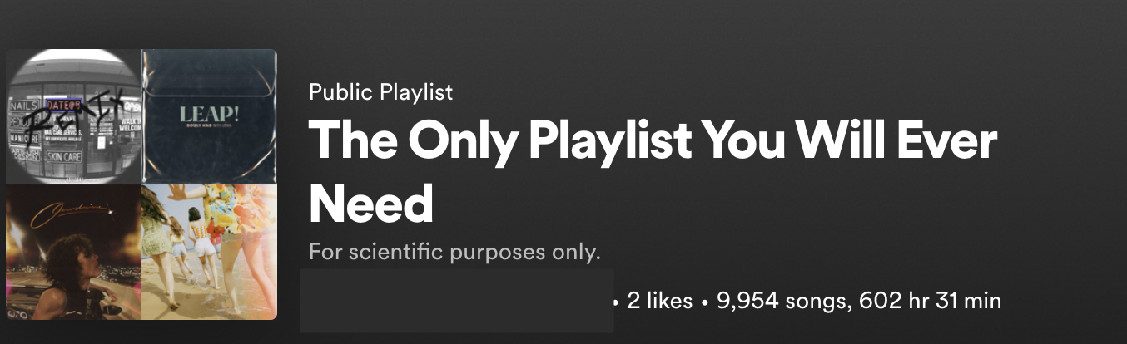
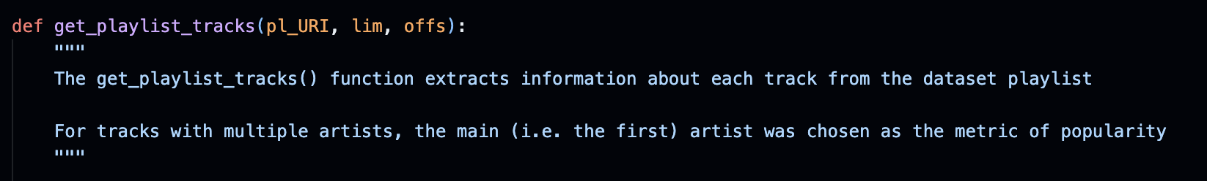
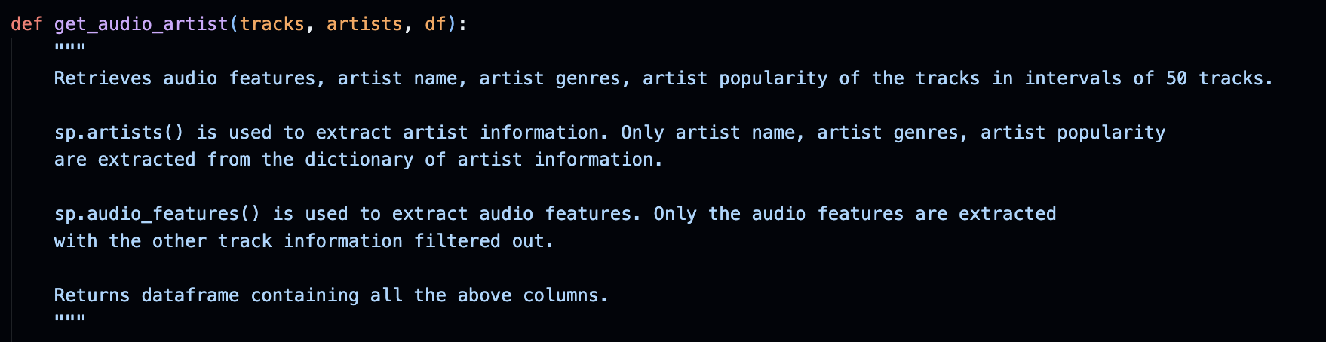
Formation of
dataset.csv
self-made playlist of around 10k songs
Two Helper Functions
01
get_playlist_tracks()
02
get_audio_artist()
Notes:
We will first go through the formation of dataset.csv, which is the main area that the Spotify API was used. For this dataset, we created our own mega playlist of around 10k songs and used the API to extract data about each song in the playlist.
Two helper functions were written to make dataset.csv.

Slide 12
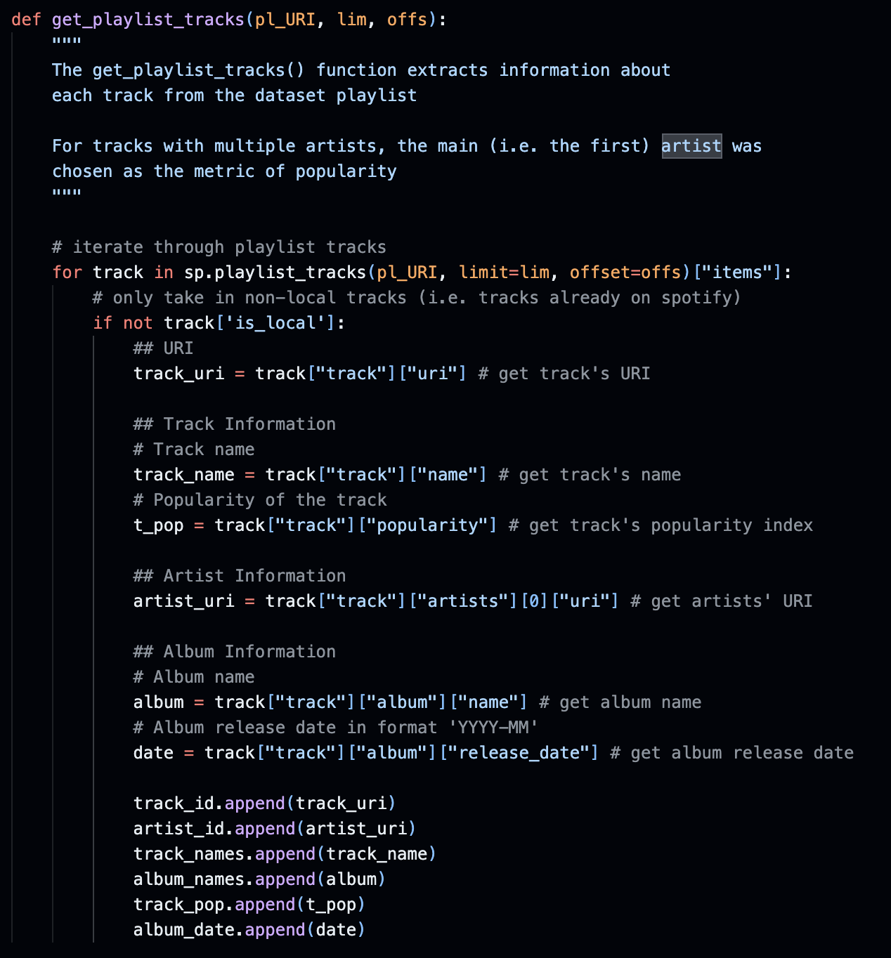
01
get_playlist_tracks()
Track Object
contains…
Track Information
Track URI
Artist URI
Track Name
Album Name
Track Popularity
Album Release Date
Artist Information
Album Information
Notes:
The get_playlist_tracks() function iterates through the playlist to retrieve the Track object of each song. This is done using the API’s playlist_tracks() function.
Overall, the features seen here are extracted.

Slide 13
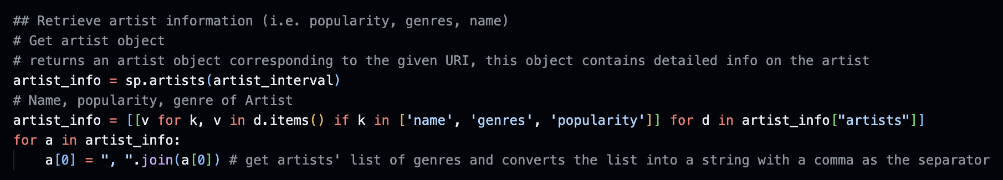
02
get_audio_artist()
Artist Name
Artist Genres
Artist Popularity
returns list of dictionaries → dictionary contains information about artist
Danceability
Energy
Key
Loudness
Mode
Speechiness
Acousticness
Instrumentalness
Liveness
Valence
Tempo
Duration
Time Signature
returns list of dictionaries → dictionary contains audio features of track
Notes:
The second helper function is get_audio_artists(). This function also uses the API, but uses the artists() and audio_features() function from the API instead to retrieve artist information and audio features using artist and track URIs.
Overall, get_audio_artists() extracts the features seen here.
This information is then written to “datasets.csv”

Slide 14


Formation of
time.csv
get_audio_pop() helper function
Kaggle Dataset
Modified Kaggle Dataset
[time.csv]
Notes:
In order to conduct a clearer analysis of Spotify tracks across time, we decided to combine datasets.csv with a Kaggle dataset that was specifically designed to compromise tracks from a wide range of eras.
We created a helper function get_artist_pop() that works similarly to get_audio_artists() to retrieve artist popularity scores for this Kaggle dataset.
This modified dataset is then written to “time.csv”.

Slide 15


Formation of
merged20k.csv
Modified Kaggle Dataset
[time.csv]
dataset.csv
merged20k.csv
Notes:
“datasets.csv” and “time.csv” are then merged to form “merged20k.csv”

Slide 16
Formation of
merged200k.csv
Note: merged200k.csv was only used for the analysis that does not require artist popularity
merged20k.csv
Kaggle dataset containing
120k songs
merged200k.csv
Notes:
To form “merged200k.csv” we combined merged20k.csv together with another Kaggle dataset containing around 120k songs

Slide 17
01B
Data Visualisation
Visualising datasets
Notes:
Data visualisation was also conducted for both merged20k and merged200k.

Slide 18
merged200k.csv
Visualisation for merged200k.csv
Notes:
For merged200k,

Slide 19
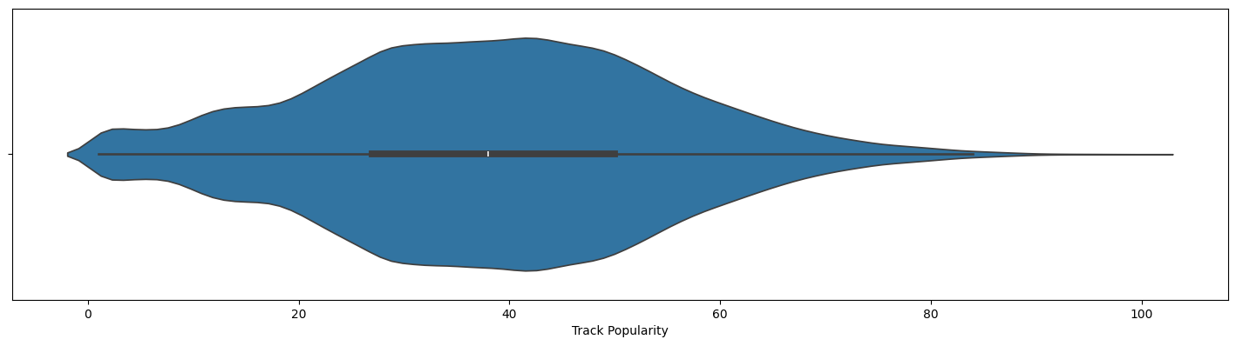
Track Popularity (Response) [merged200k.csv]
Skewed to left
Too few tracks of high popularity
DATA RESAMPLING!
Notes:
the distribution of the response variable track popularity is evidently skewed to the left, with too few tracks of high popularity. To resolve this issue, we conducted data resampling on this data which will be explained by Yuki later on.

Slide 20
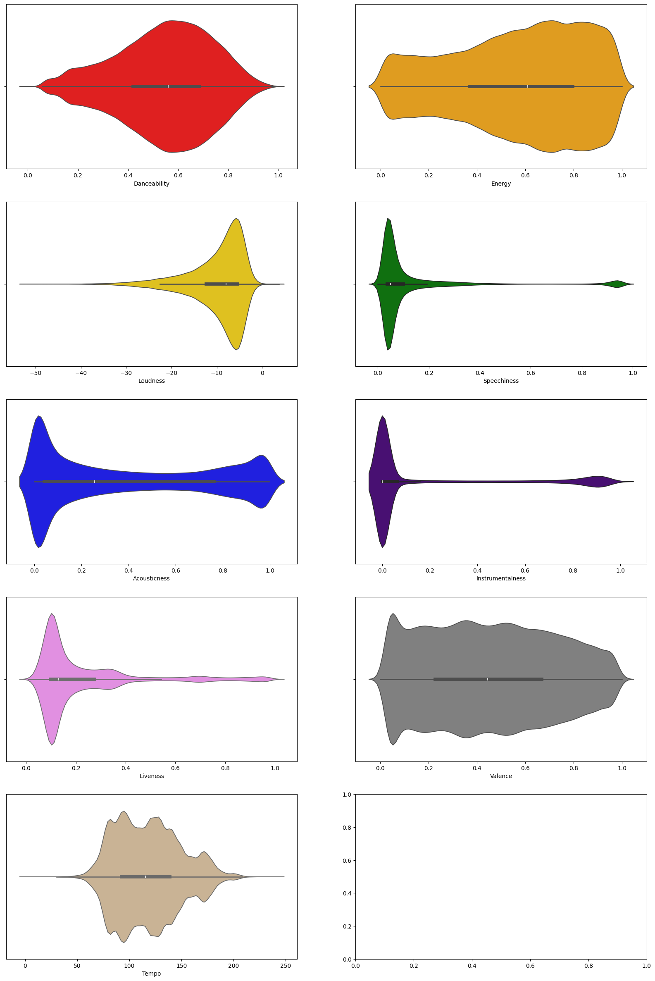
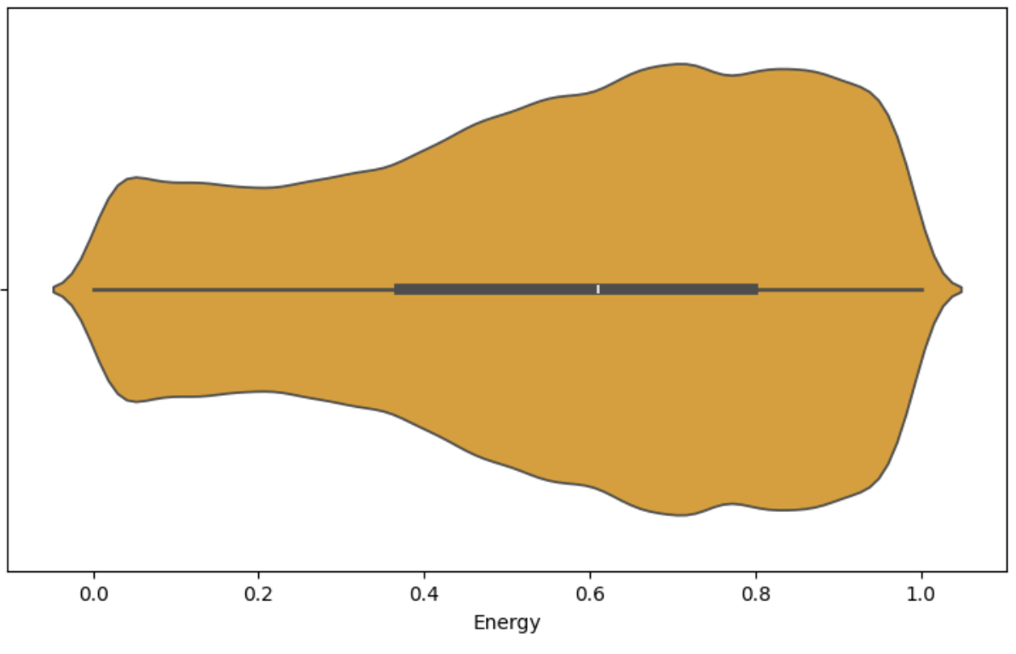
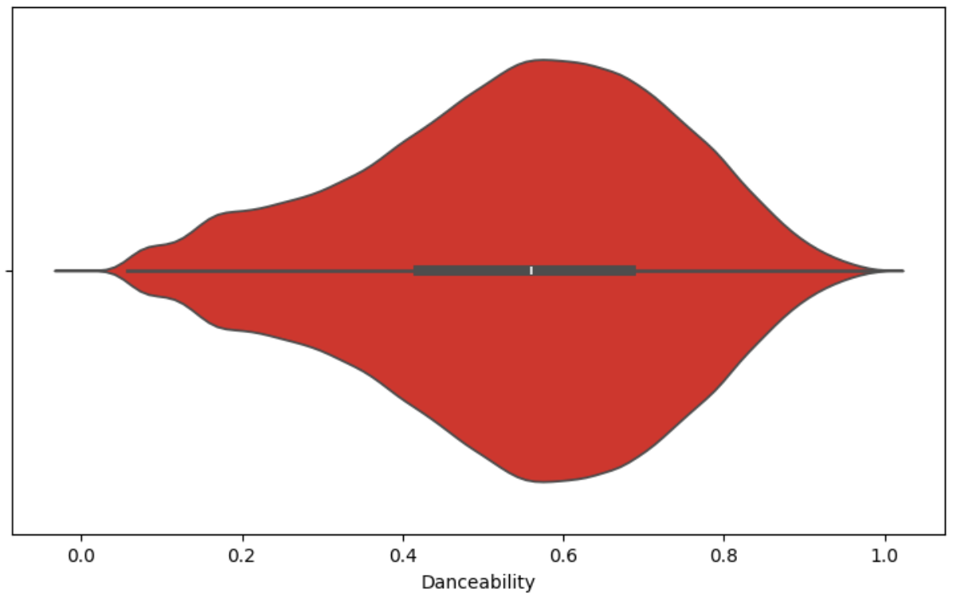
Audio Features (Predictors) [merged200k.csv]
Some have a balanced distribution
Danceability
Energy
Valence
Tempo
Notes:
As for the predictor variables, audio features, some of the variables have relatively balanced distribution such as danceability.

Slide 21
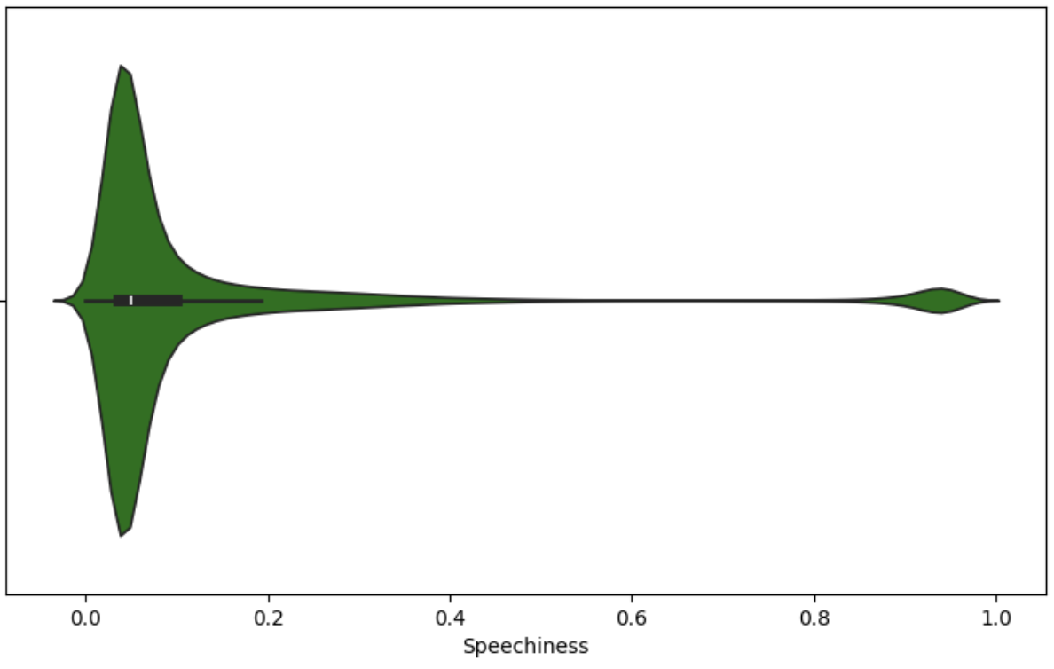
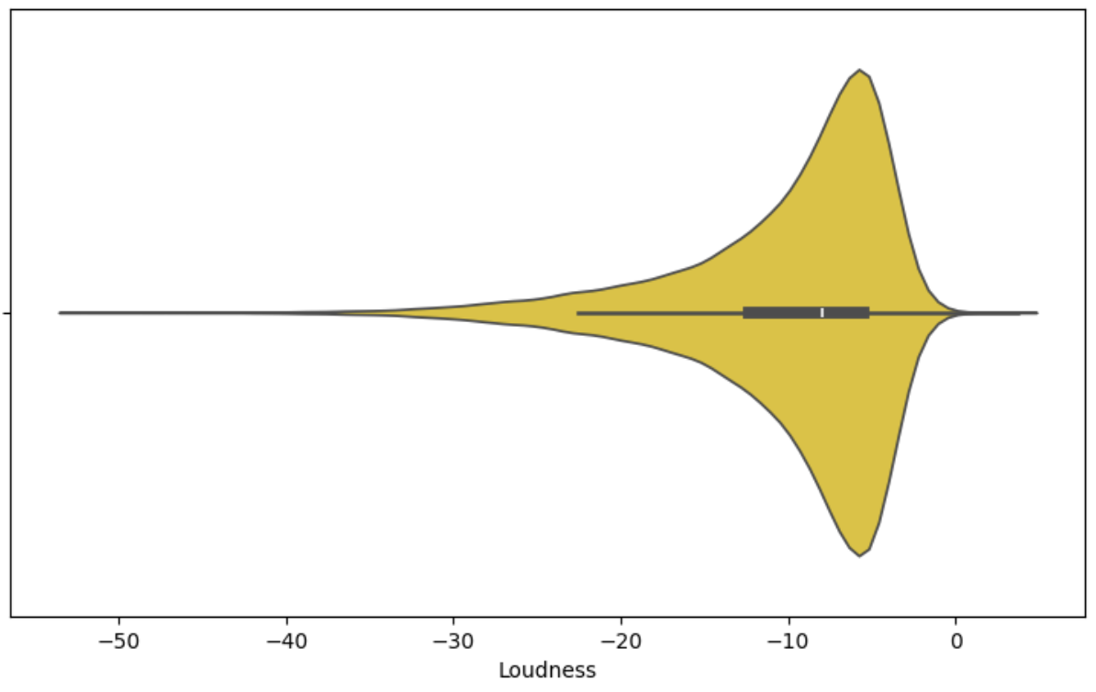
Audio Features (Predictors) [merged200k.csv]
Some have a skewed distribution
Loudness
Speechiness
Acousticness
Instrumentalness
Liveness
Notes:
While some such as loudness are skewed to one end

Slide 22
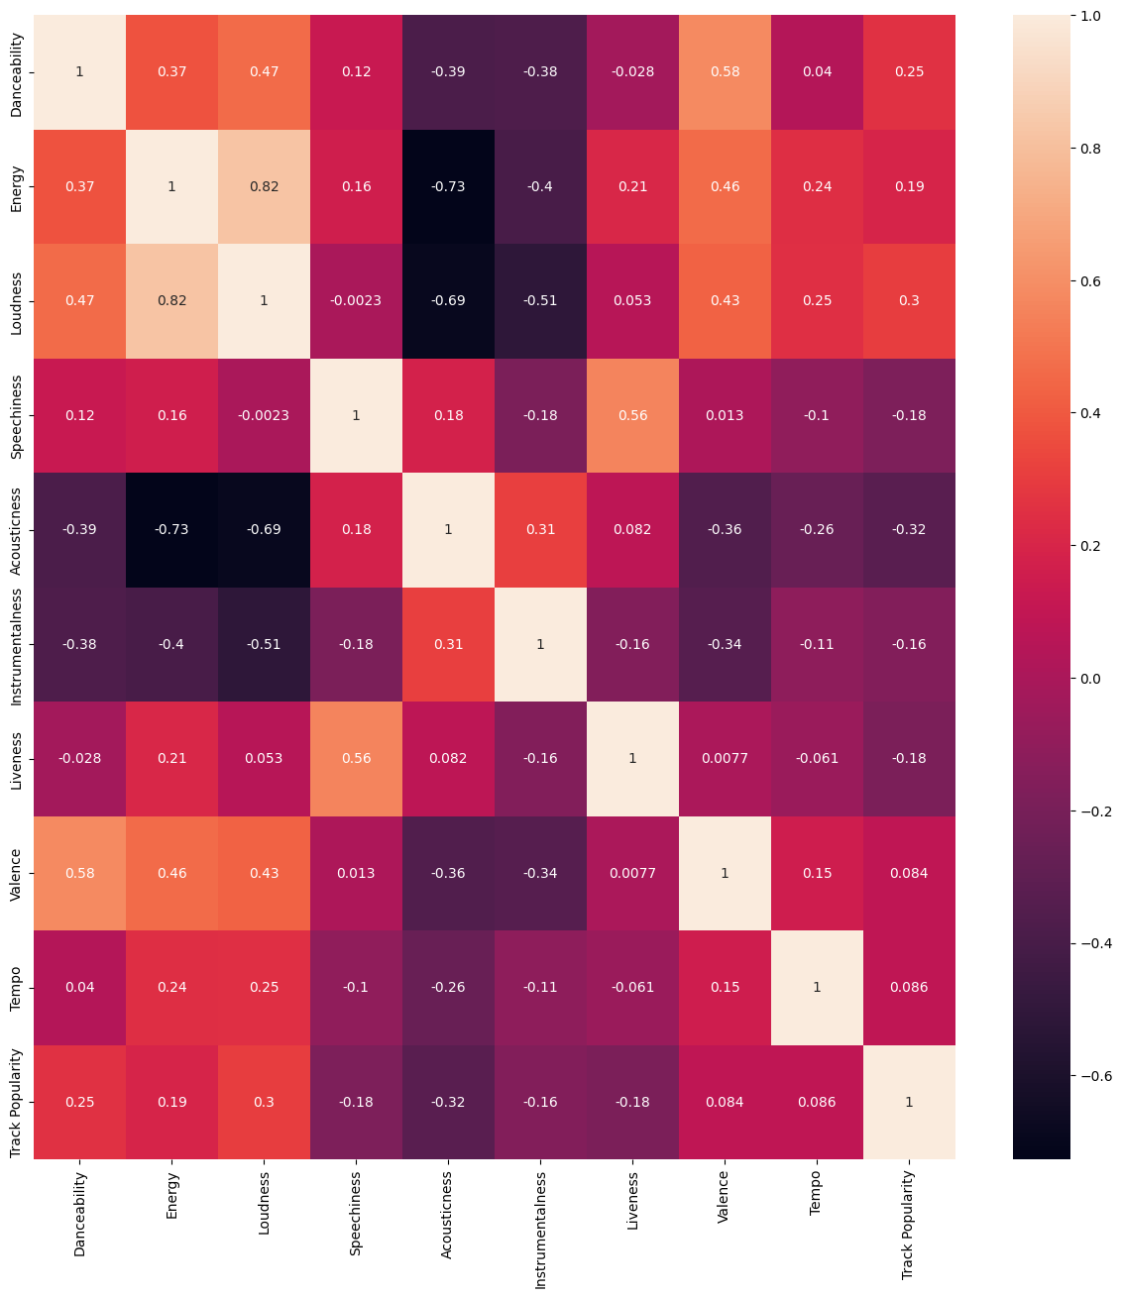
Audio Features → Track Popularity [merged200k.csv]
Notes:
When we look at the heatmap between the predictors and response, the variables actually have a low linear correlation.

Slide 23
Audio Features → Track Popularity [merged200k.csv]
Acousticness has highest linear correlation magnitude at 0.32
However…
Possibility of non-linear relationship ∴ explore non-linear models as well
Notes:
The highest is acousticness at a magnitude of 0.32. However, non-linear relationships are possible as well and it is thus important to explore non-linear models.

Slide 24
merged20k.csv
Visualisation for merged20k.csv
Notes:
Moving on to merged20k,

Slide 25
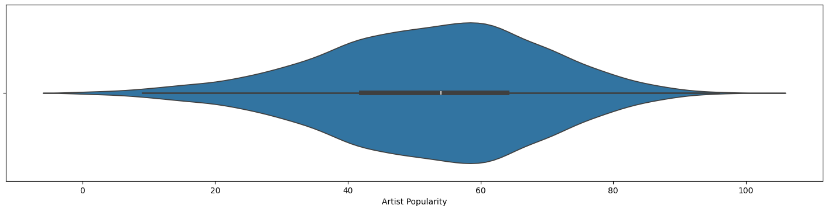
Artist Popularity (Response) [merged20k.csv]
Relatively balanced distribution
∴ resampling not conducted
Notes:
the distribution of the response variable artist popularity is relatively balanced. Thus, we did not have to conduct resampling.

Slide 26
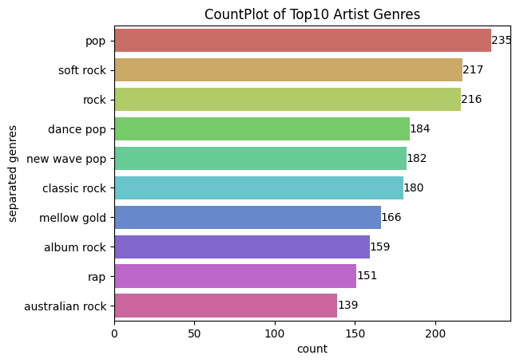
Artist Genres (Predictor) [merged20k.csv]
‘Pop → highest count of songs
Top 10 → commonly heard genres
Notes:
For the visualisation of artist genres, we decided to only visualize the top 10 genres as there were just too many genres otherwise. From this count plot, most songs have a ‘pop’ genre, which is quite expected. The other genres are commonly heard as well.

Slide 27
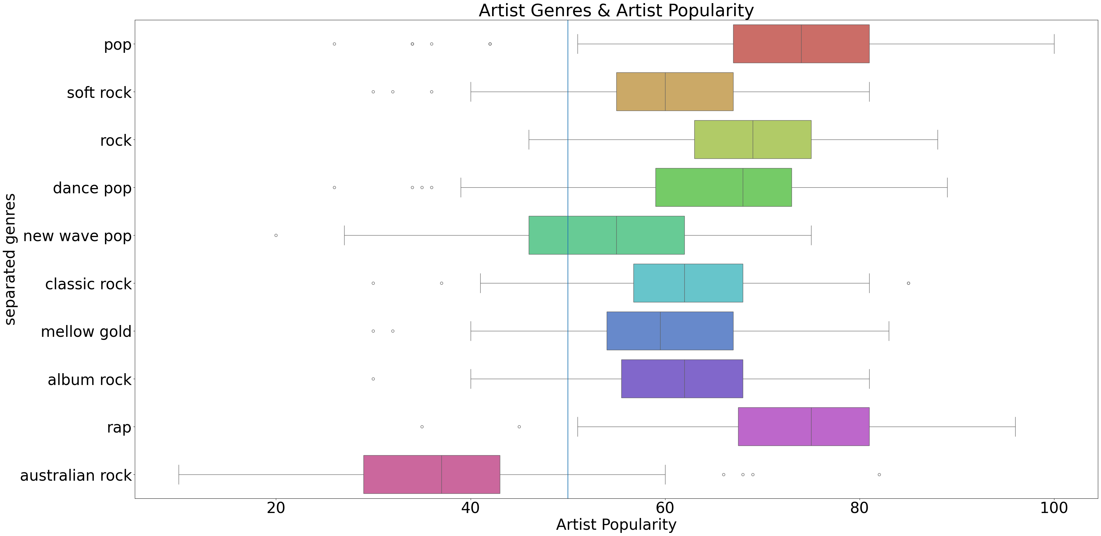
Artist Genres → Artist Popularity [merged20k.csv]
Top 10 genres correspond to popular artists
*excluding Australian Rock
Notes:
When looking at the box plot of artist genres and artist popularity, most of the top 10 genres generally correspond to popular artists.

Slide 28
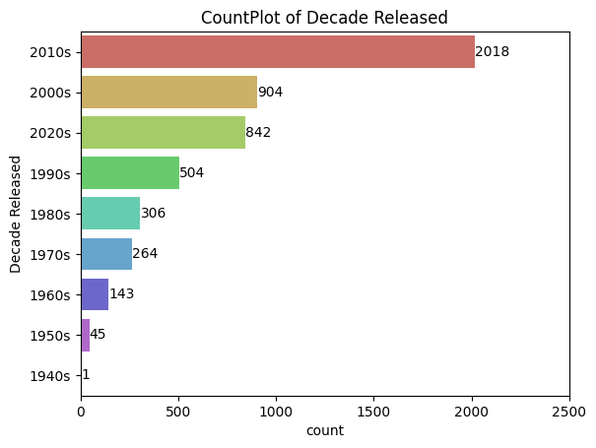
Decade Released (Predictor) [merged20k.csv]
2010s → majority of songs
21st Century → Top 3 decades
Notes:
Moving on to album release decade, the count plot tells us that many of the songs are from the 2010s. In fact, the top 3 decades are all from the 21st century. This is reasonable as Spotify is a modern app.

Slide 29
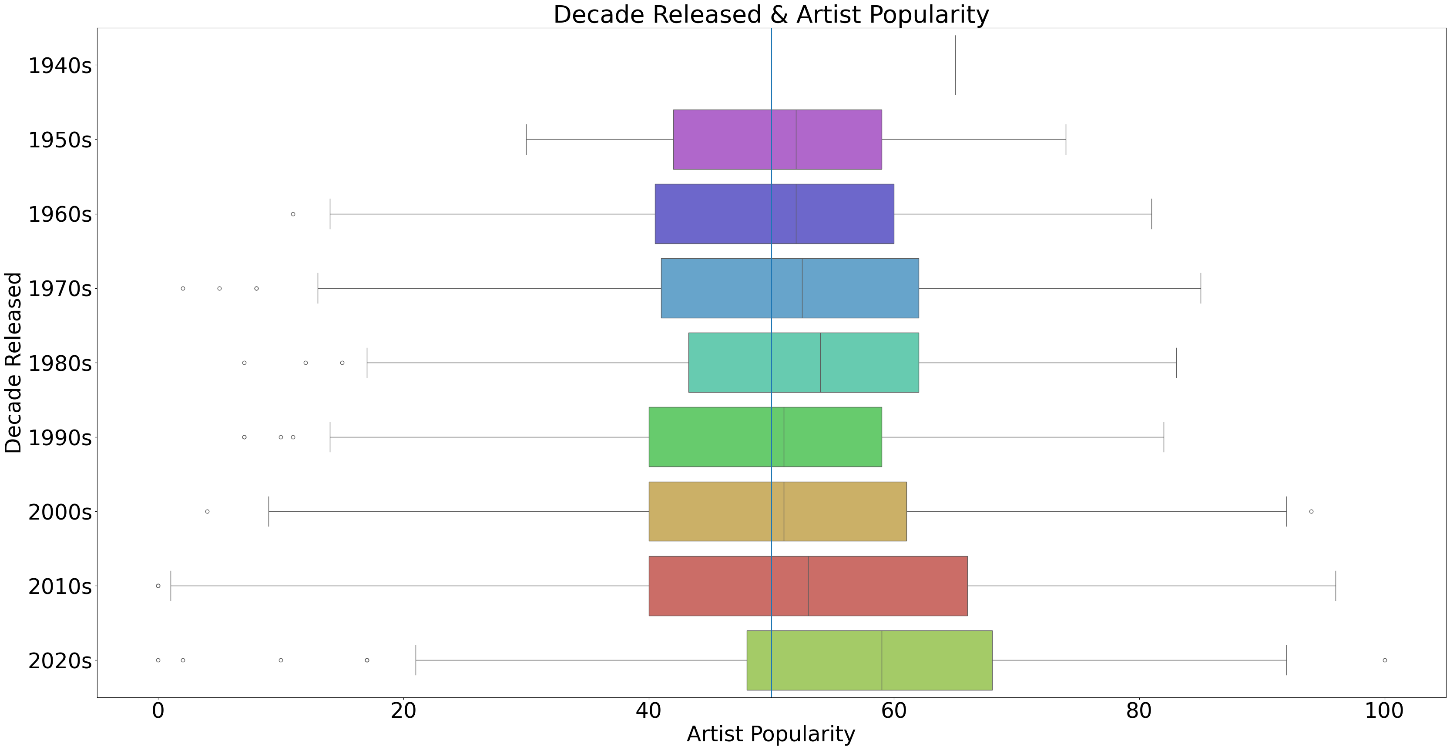
Decade Released→ Artist Popularity [merged20k.csv]
All decades have similar correlation with artist popularity
seemingly insignificant factor…
significance will be explained later – stay tuned!
Notes:
After plotting album release decade and artist popularity, we can see that most decades have track popularities that are around the middle point of 50. While this makes decade released seem like an insignificant factor, we will explain why this is not so later on.

Slide 30
02
Data Resampling
to deal with imbalanced dataset

Slide 31
SMOGN (Synthetic Minority Over-Sampling Technique for Regression with Gaussian Noise)
Recently developed in 2017
Combination of SMOTER (Synthetic Minority Over-Sampling Technique for Regression) and Gaussian Noise
Partition ‘Track Popularity’ into 2 bins → normal and rare
Normal bin will be undersampled using random undersampling
Rare bin will be oversampled using either SMOTER or Gaussian Noise
A regression resampling method
Notes:
To address this issue, we employed the Synthetic Minority Over-Sampling Technique for Regression with Gaussian Noise (SMOGN).
SMOGN first divides track popularity into two categories: normal and rare. Songs in the normal category are undersampled, while those in the rare category are oversampled using techniques like SMOTER or Gaussian noise.

Slide 32
Weighted average data point is generated!
Randomly selected from the rare bin
72
71
70
Randomly selected 9th nearest neighbor
SMOTER

Slide 33
With SMOTER, the bigger the distance between the neighboring data points, the more inaccurate it is
A combination of Finnish jazz and Bieber pop???
98
84
70
Randomly selected Justin Bieber pop song
Randomly selected Finnish jazz song

Slide 34
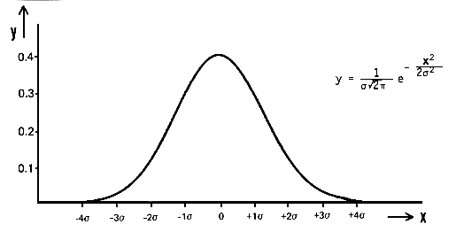
Create normal distribution of the data and select random values
New data point is generated!
Randomly selected from the rare bin
72
70
will always be close to the initial data point
Gaussian Noise

Slide 35
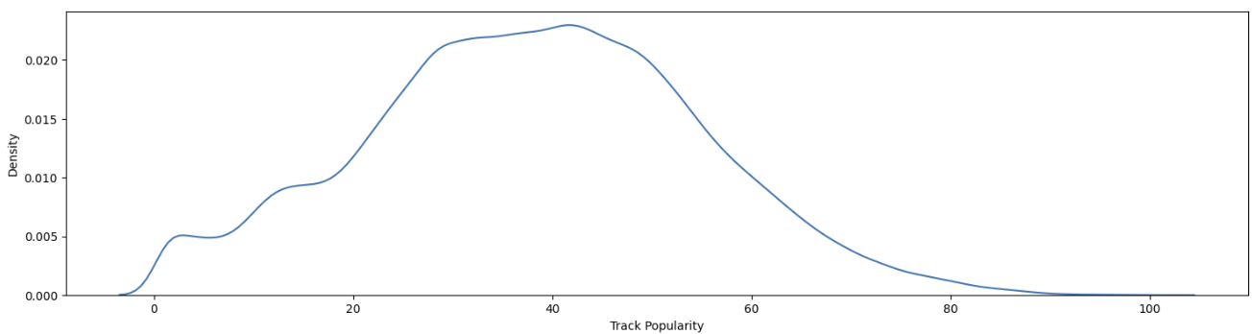
How do we partition ‘Track Popularity’
Here?
Or here?
Or even here???
Notes:
To effectively use SMOGN, we needed to establish a popularity threshold,

Slide 36
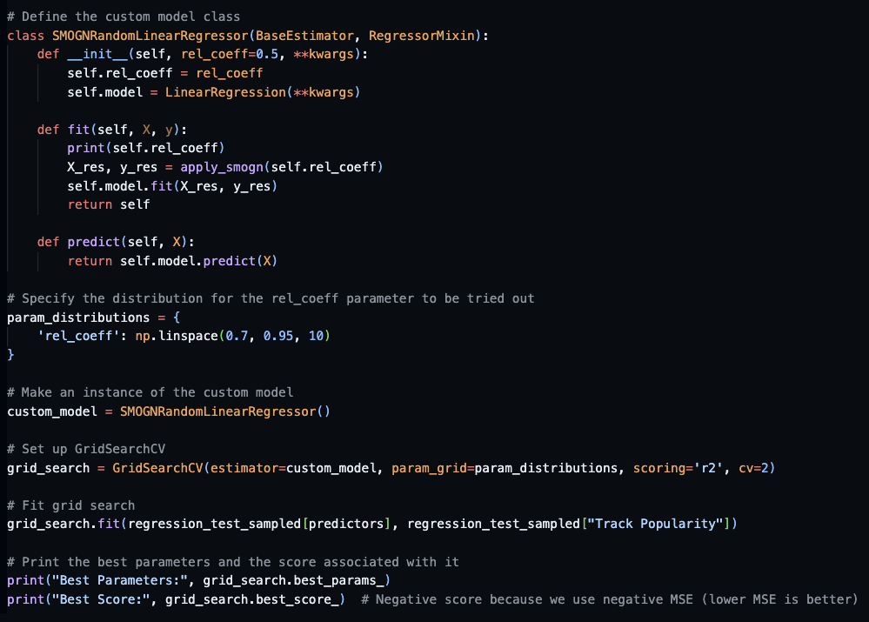
GridSearchCV
Hyperparameter-tuning technique using sci-kit learn
Basically, trial and error values between 0.7 and 0.95 until we get the model with the lowest MSE
Notes:
which was determined through hyperparameter tuning with GridSearchCV.

Slide 37
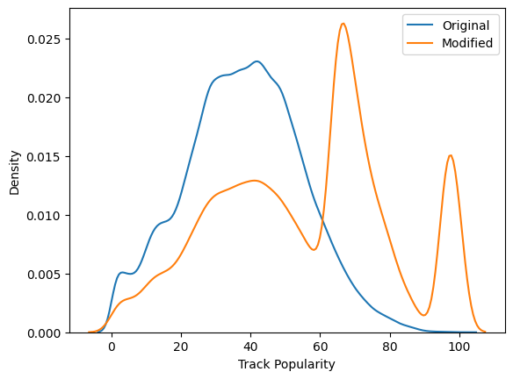
Dataset Sampled with SMOGN
This side is oversampled
This side is undersampled
Notes:
The optimal threshold identified was somewhere around 50;
Tracks with popularity scores below the threshold were placed in the normal bin and undersampled, whereas those above the threshold were classified as rare and oversampled.

Slide 38
Dataset Sampled with SMOGN
SMOGN resampling results:
Roughly equal number of popular and non-popular songs
Notes:
This method successfully balanced the dataset, providing an equal number of popular and non-popular tracks.

Slide 39
Converting Regression Problem into Classification Problem
Maybe instead of predicting a numerical score, we can predict whether it is popular or not instead?
Notes:
Now, due to reasons I will explain later, we transformed this regression problem into a binary classification problem, aiming to predict whether a track is popular.

Slide 40
'Track Popularity Cat’
not-popular 👎
POPULAR 🎉
0
1
50
Track Popularity Score
Notes:
We set the popularity threshold at 50, aligning with our earlier findings from hyperparameter tuning.

Slide 41
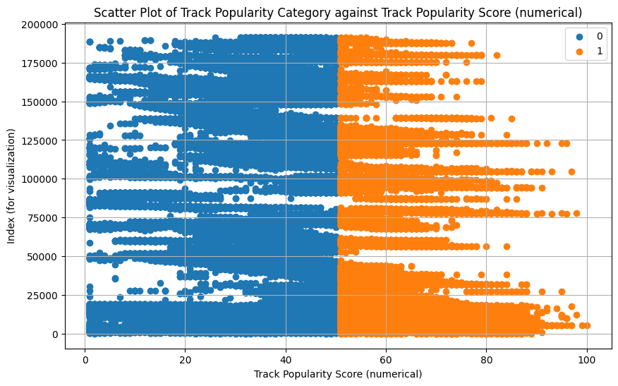
'Track Popularity Cat’

Slide 42
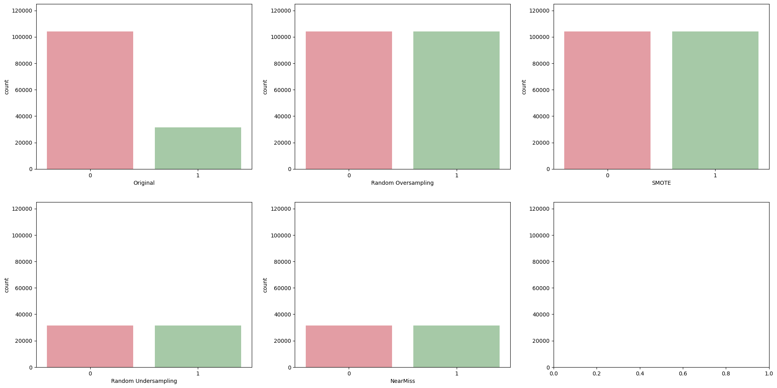
Problem with ‘Track Popularity Cat’
Too many not-popular song and too little popular songs.
IMBALANCED DATASET (again)
Time for more resampling methods for classification!
Notes:
The classification problem also presented an imbalance, with significantly more non-popular songs.
To counteract this, we employed several resampling strategies for classification.

Slide 43
Random Over-Sampling
Randomly duplicate certain values in the minority class to match the number of data points in majority class
Classification Sampling Method #1
Notes:
These included random oversampling, which duplicates entries from the minority class to equalize it with the majority class

Slide 44
SMOTE (Synthetic Minority Over-Sampling Technique)
Exactly the same as SMOGN but only done in the minority class
Increase the number of the minority class to match the majority class
Classification Sampling Method #2
Notes:
and SMOTE, which synthetically generates new minority class samples using the same technique as SMOGN.

Slide 45
Random Under-Sampling
Randomly delete certain values in the majority class to match the number of data points in minority class
Classification Sampling Method #3
Notes:
Additionally, random undersampling was used to reduce the majority class by randomly eliminating entries,

Slide 46
NearMiss
Find data points that are very close to each other, and randomly delete some of them
Decrease the number of the majority class to match the minority class
Classification Sampling Method #4
Notes:
and NearMiss, which selects close data points and randomly removes some to balance the dataset.

Slide 47
Overview of Datasets
In sampled datasets, there are equal amount of popular and not-popular songs
Notes:
After applying these sampling methods, the dataset achieved parity between the number of popular and non-popular songs, addressing the data imbalance.

Slide 48
03
Predicting Artist Popularity
from Artist Genre and Decade

Slide 49
Why the chosen independent variables?
Artist Genre
Decade of Album Release
Certain genres are more popular than others
Combinations of artist genres may be a significant predictor of artist popularity
People's preference to genres tend to change temporally
We use the decade the artist released an album as an indicator of when the artist is active

Slide 50
Preparing Artist Genres for Regression
Artist genres are categorical data with multiple labels
Need to be converted into binary format
Artist | Genre
Justin Bieber | Canadian Pop
Taylor Swift | Pop
Bruno Mars | Pop, Dance Pop
Westlife | Boy Band
One Direction | Boy Band, Pop, Post-teen pop, Talent show

Slide 51
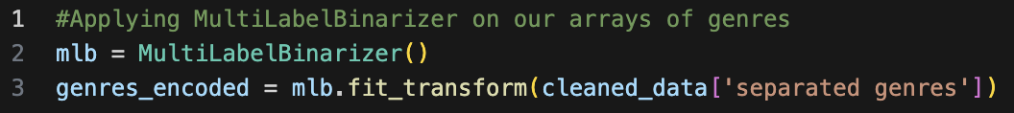
Preparing Artist Genres for Regression
MultiLabelBinarizer
 | Pop | Canadian Pop | Dance Pop | Boy Band | Post-teen pop | Talent show
Justin Bieber | 1 | 1 | 0 | 0 | 0 | 0
Taylor Swift | 1 | 0 | 0 | 0 | 0 | 0
Bruno Mars | 1 | 0 | 1 | 0 | 0 | 0
Westlife | 0 | 0 | 0 | 1 | 0 | 0
One Direction | 1 | 0 | 0 | 1 | 1 | 1

Slide 52

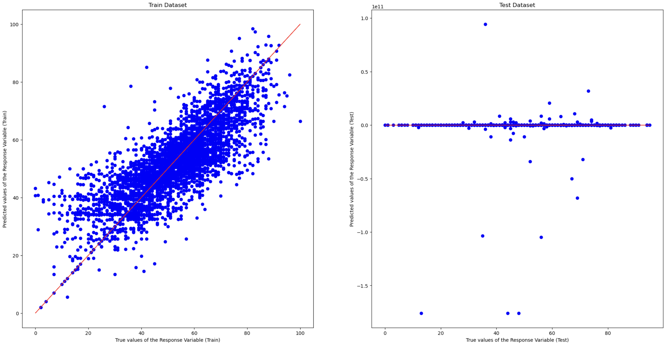
Linear Regression
Train Dataset
RMSE: 9.36
R2: 0.672
Test Dataset
RMSE: 11594903624
R2: -4.8 * 10¹⁷
Likely due to noise in our data

Slide 53
Other models (Test Dataset)
Lasso Regression
Random Forest Regression
RMSE: 12.8
R2: 0.412
RMSE: 11.7
R2: 0.513
Gradient Boosting with Decision Trees
Neural Network
RMSE: 12.9
R2: 0.407
RMSE: 12.3
R2: 0.460

Slide 54
Other models (Test Dataset)
Lasso Regression
Random Forest Regression
RMSE: 12.8
R2: 0.412
RMSE: 11.7
R2: 0.513
Gradient Boosting with Decision Trees
Neural Network
RMSE: 12.9
R2: 0.407
RMSE: 12.3
R2: 0.460

Slide 55
Random Forest Regression
Train Input
Random Forest Regression works by constructing multiple decision trees
(…)
Tree 1
Tree 2
Tree n

Slide 56
Random Forest Regression
Train Input
Random Forest Regression works by constructing multiple decision trees
When splitting a node, it randomly selects a subset of the features as candidates for the split
Decade released >2000s?
Pop?
Rap?
(…)
Tree 1
Tree 2
Tree n

Slide 57
Random Forest Regression
Test Input
Random Forest Regression works by constructing multiple decision trees
When splitting a node, it randomly selects a subset of the features as candidates for the split
Each tree will output a prediction value
The model will return the average of these predictions
Decade released >2000s?
Pop?
Rap?
(…)
Tree 1
Tree 2
Tree n
(…)
Prediction 1
Prediction 2
Prediction n

Slide 58
Random Forest Regression
Test Input
Random Forest Regression works by constructing multiple decision trees
When splitting a node, it randomly selects a subset of the features as candidates for the split
Each tree will output a prediction value
The model will return the average of these predictions
Decade released >2000s?
Pop?
Rap?
(…)
Tree 1
Tree 2
Tree n
(…)
Prediction 1
Prediction 2
Prediction n
Output: Average

Slide 59
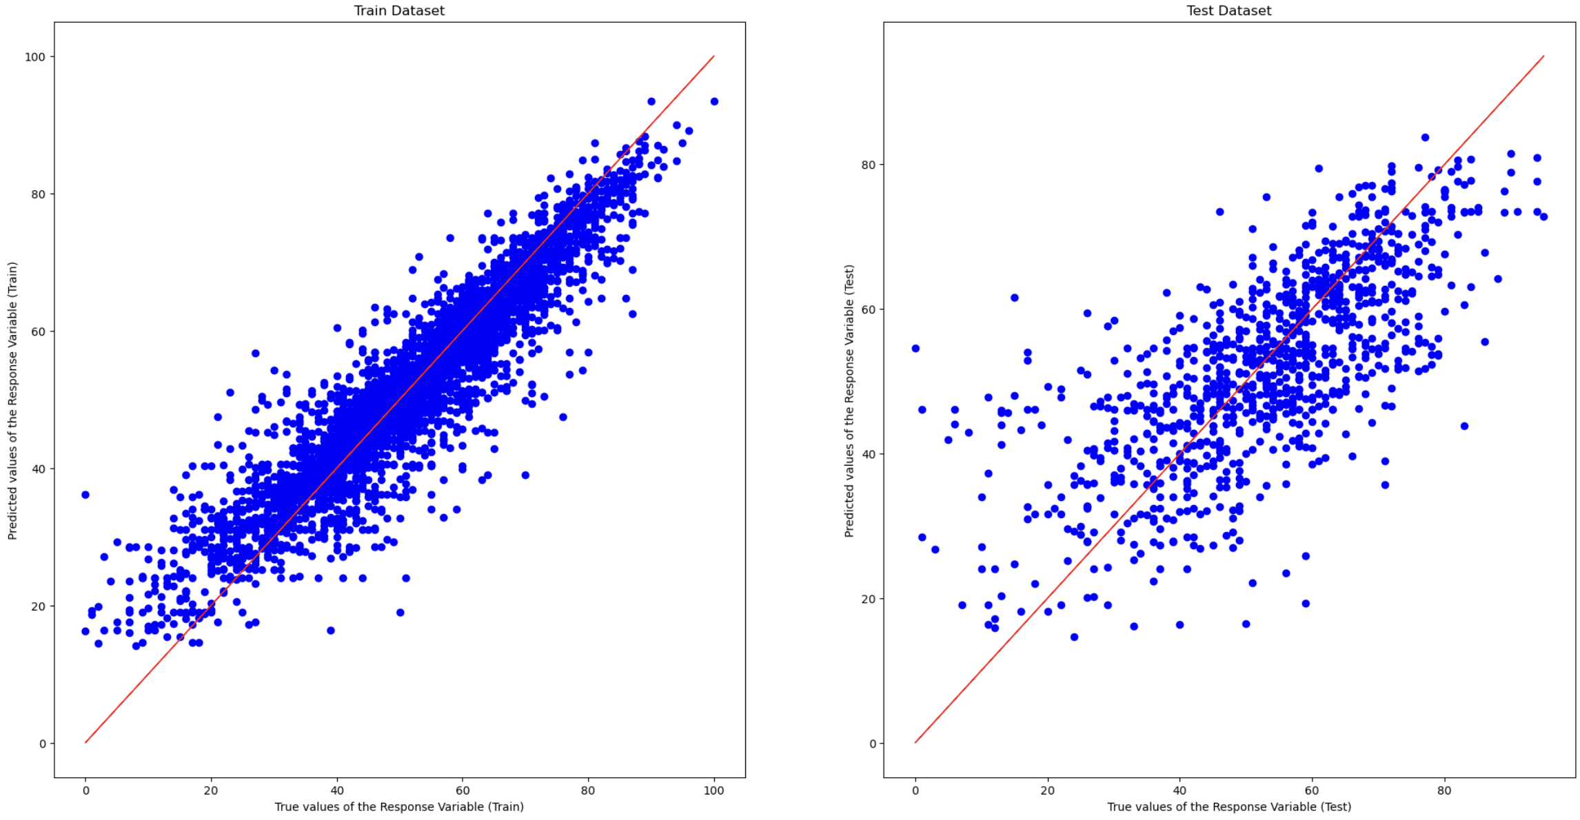
Random Forest Regression
Train Dataset
RMSE: 6.10
R2: 0.860
Test Dataset
RMSE: 11.7
R2: 0.513
Good for capturing complex interactions between predictor variables

Slide 60
Classification Problem
Predicting if an artist is popular/ unpopular

Slide 61
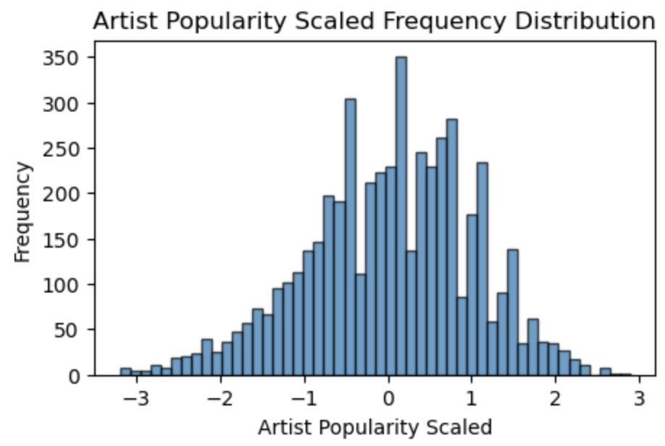
Threshold for popularity
Scale and normalise artist popularity such that mean = 0 and standard deviation = 1
Any artists with a scaled popularity >0 will be deemed popular

Slide 62
Classification models
Logistic Regression
Logistic Lasso Regression
True Positive Rate: 0.73
True Negative Rate: 0.80
False Positive Rate: 0.20
False Negative Rate: 0.27
Overall Accuracy: 0.763
True Positive Rate: 0.70
True Negative Rate: 0.84
False Positive Rate: 0.16
False Negative Rate: 0.30
Overall Accuracy: 0.764
Random Forest Classifier
Support Vector Machines
True Positive Rate: 0.75​
True Negative Rate: 0.77​
False Positive Rate: 0.23​
False Negative Rate: 0.25​
Overall Accuracy: 0.757
True Positive Rate: 0.77​
True Negative Rate: 0.74​
False Positive Rate: 0.26​
False Negative Rate: 0.23​
Overall Accuracy: 0.753

Slide 63
Classification models
Logistic Regression
Logistic Lasso Regression
True Positive Rate: 0.73
True Negative Rate: 0.80
False Positive Rate: 0.20
False Negative Rate: 0.27
Overall Accuracy: 0.763
True Positive Rate: 0.70
True Negative Rate: 0.84
False Positive Rate: 0.16
False Negative Rate: 0.30
Overall Accuracy: 0.764
Random Forest Classifier
Support Vector Machines
True Positive Rate: 0.75​
True Negative Rate: 0.77​
False Positive Rate: 0.23​
False Negative Rate: 0.25​
Overall Accuracy: 0.757
True Positive Rate: 0.77​
True Negative Rate: 0.74​
False Positive Rate: 0.26​
False Negative Rate: 0.23​
Overall Accuracy: 0.753

Slide 64
Logistic Lasso Regression
Lasso Regularisation
Logistic Regression
Least Absolute Shrinkage and Selection Operator
Useful for feature selection since it can shrink the coefficients of less important features to zero
Manages multicollinearity and model complexity
A type of regression used to predict the outcome of a categorical dependent variable (i.e. Popular vs Unpopular)
Logistic Lasso Regression
(Removed 1,375 columns of genres!)

Slide 65
Prediction Tool
Estimate Artist Popularity based on inputs

Slide 66
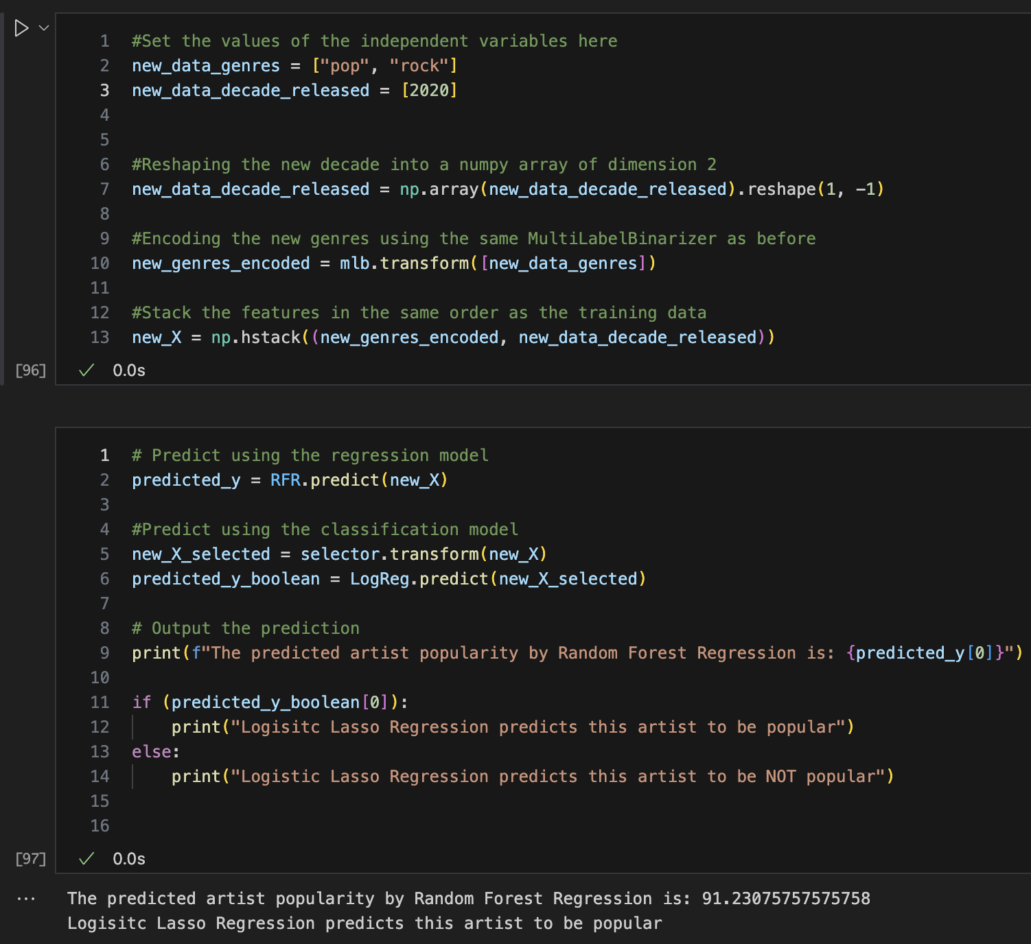
Prediction tool
We are able to key in the genre and decade released manually here
Popularity score will be displayed
We can evaluate whether the artist is worth investing resources in

Slide 67
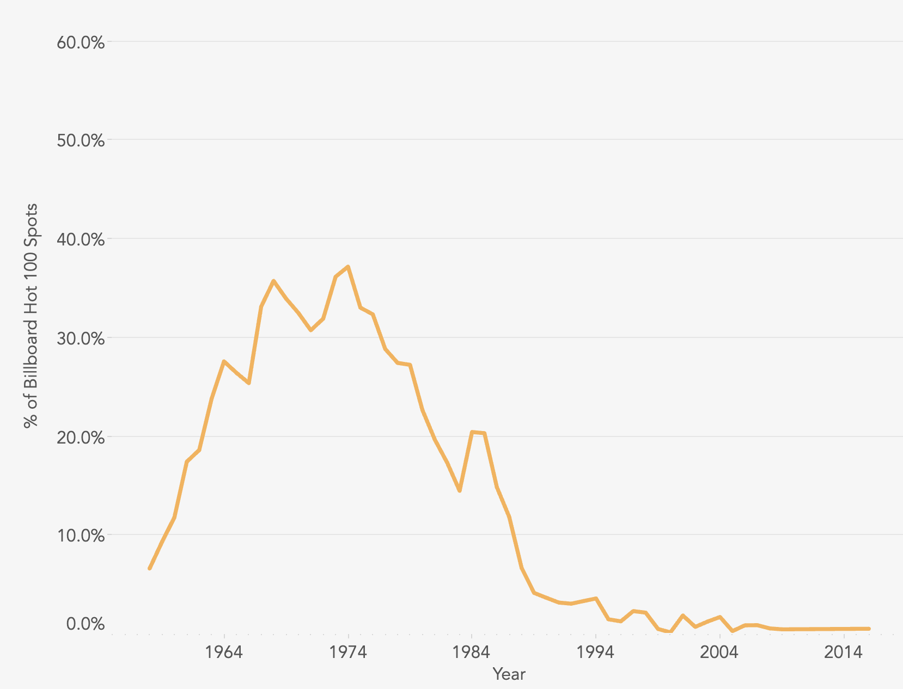
Why is release decade significant?
The Data Face. (2016, September). Genre lifecycles. The Data Face. https://thedataface.com/2016/09/culture/genre-lifecycles
Using our predictor tool
Genre: "Soul"
Decade: 2020
Predicted Popularity: 54.1
Genre: "Soul"
Decade: 1980
Predicted Popularity: 60.8

Slide 68
04
Predicting Track Popularity
from audio features
Notes:
After signing an artist, an agency must guide them to produce popular tracks.

Slide 69
Audio Features?
Danceability
Energy
Loudness
Speechiness
Acousticness
Instrumentalness
Liveliness
Valence
Tempo
For more details, check Spotify API’s documentation here
Notes:
To aid this, we developed a model to predict track popularity using audio features.

Slide 70
Datasets Used in Regression
merged200k.csv
train/test split
for non-sampled dataset
train/test split
for non-sampled dataset
regression_test
regression_train
sampled using SMOGN
Why?
so that the test dataset is the same for fair comparison
df_smogn
Notes:
We first split the `merged200k` dataset into `regression_test` and `regression_train`, using SMOGN to sample ONLY the `regression_train` for comparison under consistent test conditions.

Slide 71
Linear Regression Results
Non-sampled Dataset (Train)
Non-sampled Dataset (Test)
R2 score: 0.19
RMSE: 15
R2 score: 0.19
RMSE: 15
SMOGN Dataset (Train)
SMOGN Dataset (Test)
R2 score: 0.52
RMSE: 17
R2 score: -0.16
RMSE: 18
Notes:
Our initial results with linear regression showed the best R2 score is with the SMOGN-sampled training set, but the SMOGN-sampled test set performs miserably,

Slide 72
Linear Regression Results
SMOGN Dataset (Train)
SMOGN Dataset (Test)
R2 score: 0.52
RMSE: 17
R2 score: -0.16
RMSE: 18
Why is the test result so bad?
Probably overfitting. At some popularity score, there are significantly more synthetic data points than real data points. So, the model is more tuned to synthetic data instead of real data → performs miserably in test data, which is real
Notes:
Indicating overfitting to synthetic data.

Slide 73
Regression Models on Non-Sampled Dataset
Linear, Ridge and Lasso Regression
R2 score: 0.19
RMSE: 15
Decision Tree
Random Forest
R2 score: 0.23
RMSE: 15
R2 score: 0.21
RMSE: 15
Gradient Boosting
Extra Tree Regression
R2 score: 0.28
RMSE: 14
R2 score: 0.27
RMSE: 14
Notes:
Consequently, we explored other regression models on non-sampled data, finding the [press next] Gradient Boosting model the most effective.

Slide 74
Regression Models on Non-Sampled Dataset
K-Fold Cross Validation
Gradient Boosting
R2 score: 0.28
RMSE: 14
Average R2 score: 0.23
Average RMSE score: 16
Basically, try different train/test split and take average R2 and RMSE score
Awful and depressing :(
Notes:
However, K-fold cross-validation only yielded an average R2 score of 0.23 and an RMSE of 16, which were pretty bad.

Slide 75
Converting Regression Problem into Classification Problem
We can definitely do better!
Notes:
So, we shifted our approach to a classification problem to determine whether a song is popular.

Slide 76
Datasets Used in Classification
merged200k_classification.csv
classification_test will be the common test dataset for fair comparison
train/test split
for non-sampled dataset
train/test split
for non-sampled dataset
classification_test
classification_train
random oversampled
nearmiss
SMOTE
random undersampled
Notes:
We take the merged200k_classification dataset, train/test split, and sample the training dataset using various methods explained before.

Slide 77
Logistic Regression Results
Non-sampled Dataset (Train)
True positive rate: 0.06
True negative rate: 0.99
False positive rate: 0.01
False negative rate: 0.94
Overall accuracy: 0.77
THAT’S AWFUL!
Only 6% of actual popular songs are predicted to be popular by the model.
HOW COME?
Notes:
Logistic regression on the non-sampled data revealed a very low true positive rate

Slide 78
Problem with ‘Track Popularity Cat’
Too many not-popular song and too little popular songs.
IMBALANCED DATASET (again)
This means that classification models are more likely to classify songs as not popular, as they are fed with overwhelmingly negative data points in the training dataset
Notes:
due to an imbalanced training dataset with a majority of non-popular songs.

Slide 79
Logistic Regression Results
Random Over-Sampling Dataset
SMOTE Dataset
True positive rate: 0.76
False positive rate: 0.44
Overall accuracy: 0.60
True positive rate: 0.74
False positive rate:0.43
Overall accuracy: 0.61
Random Under-Sampling Dataset
NearMiss Dataset
True positive rate: 0.76
False positive rate: 0.44
Overall accuracy: 0.60
True positive rate: 0.68
False positive rate: 0.39
Overall accuracy: 0.63
Notes:
Resampling the dataset improved performance significantly.
The NearMiss resampled dataset achieved the highest accuracy, but other resampled datasets, like random oversampling, undersampling, and SMOTE, offered higher true positive rates.

Slide 80
Random Forest in Sampled Datasets
Random Over-Sampling Dataset
SMOTE Dataset
True positive rate: 0.32
False positive rate: 0.1
Overall accuracy: 0.77
True positive rate: 0.55
False positive rate: 0.26
Overall accuracy: 0.70
Random Under-Sampling Dataset
NearMiss Dataset
True positive rate: 0.73
False positive rate: 0.38
Overall accuracy: 0.65
True positive rate: 0.61
False positive rate: 0.30
Overall accuracy: 0.68
Notes:
Subsequent testing with different classification models showed that the random forest classifier was superior.
These are the final results
So which model should agencies use? Depends on the context.

Slide 81
Which Model to Use?
01
Random Over-Sampling Dataset
True positive rate: 0.32
False positive rate: 0.1
Overall accuracy: 0.77
Good for up-and-coming agency who does not have a lot of funds (low-risk, low return)
Can’t afford making songs that are not popular → make use of the model low false positive rate
Notes:
For a new agency with limited resources, a model trained on a randomly oversampled dataset would be advisable because it cautiously predicts fewer songs as popular, minimizing financial risk.

Slide 82
Which Model to Use?
02
Good for big agency with a lot of money and is willing to take risks (high-risk, high-return)
If the song is indeed popular, the model will predict quite accurately that is popular → high true positive rate
At the expense of making more unpopular songs too → high false positive rate
Random Under-Sampling Dataset
True positive rate: 0.73
False positive rate: 0.38
Overall accuracy: 0.65
Notes:
In contrast, a model trained on a randomly undersampled dataset, which predicts more songs as popular, suits a larger, financially robust agency willing to risk occasional losses for more hit songs.

Slide 83
Which Model to Use?
03
SMOTE Dataset
True positive rate: 0.55
False positive rate: 0.26
Overall accuracy: 0.70
04
NearMiss Dataset
For medium-sized agency that is in-between the first two
Medium-risk, medium-return
True positive rate: 0.61
False positive rate: 0.30
Overall accuracy: 0.68
Notes:
SMOTE and NearMiss sampled datasets offer balanced options for agencies looking for a middle ground in prediction outcomes.
In summary, the choice of model and sampling method must align with the agency’s risk tolerance and resource availability.

Slide 84
THANK YOU
Notes:
And that concludes our presentation. Thank you.

